Slide 1
NLP bootcamp

Slide 2
Agenda
Natural Language Processing
GluonNLP
Amazon SageMaker
Demo

Slide 3
Current State of Natural Language Processing
Text synthesis
Content:
Style:
Two dogs play by a tree.
happily, love
Synthesized text:
Two dogs in love play happily by a tree.

Slide 4
Natural language processing nowadays
Question answering
Question: Who shall use GluonNLP?
Passage context: GluonNLP provides implementations of the state-of-the-art (SOTA) deep learning models in NLP, and build blocks for text data pipelines and models. It is designed for engineers, researchers, and students to fast prototype research ideas and products based on these models.

Slide 5
Tokenization – basic strategies
“Buy 5000m3 Dec CFT, WTI -9.25, Equinor US, OX, USD, B McBride”
Character level
Word Level
['B', 'u', 'y', ' ', '5', '0', '0', '0', 'm', '3', ' ', 'D', 'e', 'c', ' ', 'C', 'F', 'T', ',', ' ', 'W', 'T', 'I', ' ', '-', '9', '.', '2', '5', ',', ' ', 'E', 'q', 'u', 'i', 'n', 'o', 'r', ' ', 'U', 'S', ',', ' ', 'O', 'X', ',', ' ', 'U', 'S', 'D', ',', ' ', 'B', ' ', 'M', 'c', 'B', 'r', 'i', 'd', 'e']
['Buy', '5000m3', 'Dec', 'CFT,', 'WTI', '-9.25,', 'Equinor', 'US,', 'OX,', 'USD,', 'B', 'McBride']

Slide 6
Advanced Tokenization
Byte-pair encoding (recursively) reduces byte-pairs to new bytes to both compress and reduce commonly occurring byte-pairs.
“environment, mentally” →
[65 6e 76 69 72 6f 6e 6d 65 6e 74 2c 20 6d 65 6e 74 61 6c 6c 79]
So ‘ment’ or [6d 65 6e 74] would become a new byte.
Reduces out-of-vocab issues with new words due to possible fallback on single bytes
Captures shared semantic information of sub-word token
Result (in utf-8 encoded bytes)
['▁buy', '▁0000', 'm', '0', '▁oct', '▁c', 'pr', ',', '▁w', 'ti', '-0,', '▁tour', 'mal', 'ine', '▁oil', ',', '▁spect', 'ron', '▁uk', ',', '▁us', 'd', ',', '▁b', '▁cole']
Notes:
double check direction comment

Slide 7
Grapheme/token representation in NLP
Define words as a vector
bag-of-words approach where sentence is sum of word vectors.
Deep
learning
is
fun

Slide 8

Limitations: no semantic information
remember:
-$L2 Norm={|\left|v\right||}_{2}= \sqrt{\sum_{k=1}^{n}{{x_{k}}^{2}}}$
0
0
0
1
0
0
0
1
0
0
0
0
0
0
0
0
0
1
0
0
0
0
0
0
0
0
0
1
-
=
-
= √2
2
2
|| v_{automobile} – v_{car} ||₂ = || v_{automobile} – v_{mountain} ||₂ = √2
Ideally we would want:
|| v_{automobile} – v_{car} ||₂ ≈ 0

Slide 9
Embedding
went – going = walked - walking
Word embeddings
Vector representations of words
Deep
learning
z
is
Word2Vec (shallow word embeddings)
fun
Training
Models central words given context words
went
walked
going
Deep learning is fun!
P(learning | deep, is, fun)
walking
x
y
Prediction
Inferences via vector lookups
Word analogy in Word2Vec

Slide 10
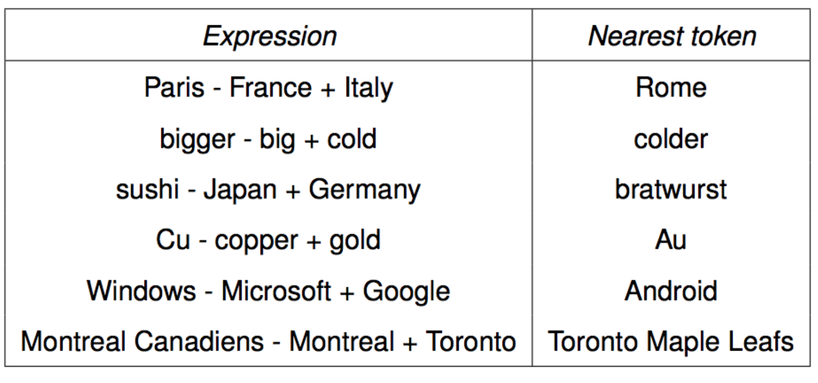

Slide 11
Representation learning with BERT
Word embeddings
Vector representations of words
Word2Vec (shallow)
Amazon is on fire…
BERT (deep)
Bidirectional, “contextual”, deep
Masked language modeling
AWS re-invent is awesome.
[MASK]
Outputs: P(re-invent | AWS, [MASK], is, awesome)
BERT pre-training

Slide 12
BERT Fine-tuning
Sentiment analysis
BERT fine-tuning (sentiment analysis)
Output: positive
Embedding:
Input:
Input: AWS re-invent is awesome.

Slide 13
BERT Fine-tuning
Name entity recognition (NER)
BERT fine-tuning (NER)
Output:
Output: Organization, Location, Person, None, etc.
Embedding:
Input:
Input: AWS re-invent is in Las Vegas.

Slide 14
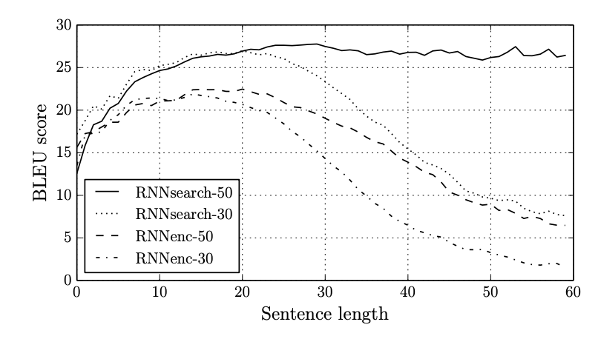
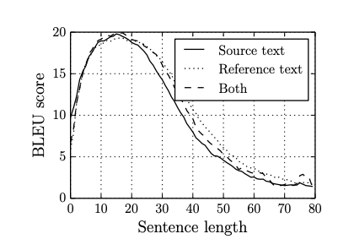
Attention
Problem
Seq2seq context vector has trouble remembering long input sentences
*Cho et al. 2014 – “On the Properties of Neural Machine Translation: Encoder–Decoder Approaches”
*Bahdanau et al. 2015 – “Neural Machine Translation by Jointly Learning to Align and Translate”
Solution
Attention* based models create learned attention vector that measures how much a single word or pixel ”attends” with the other input
*Bahdanau et al. 2015 – “Neural Machine Translation by Jointly Learning to Align and Translate”

Slide 15
Self-attention on sentence Self-attention: “The apple is red, it is delicious”
The
apple
is
red
,
it
is
delicious
The
apple
is
red
,
it
is
delicious
The
apple
is
red
,
it
is
delicious

Slide 16
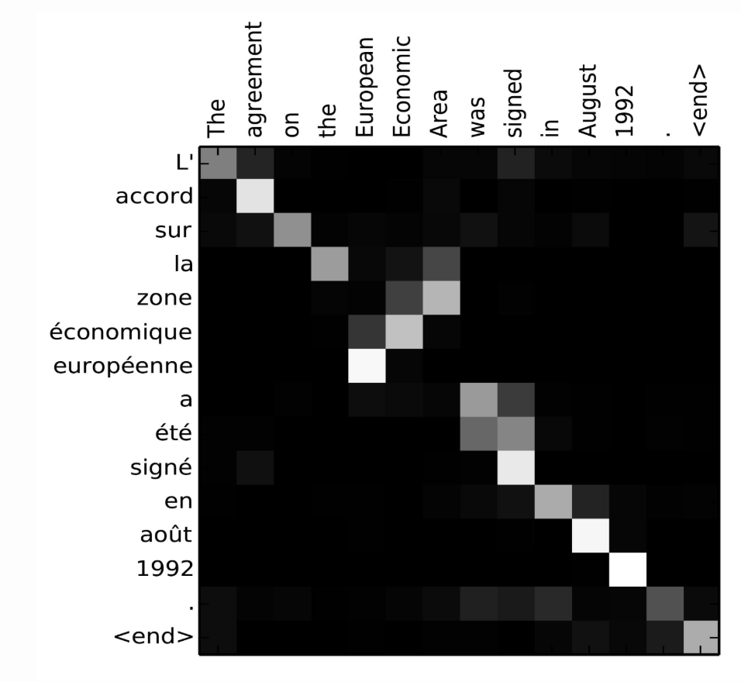

Attention matrix
$α_{t,i}$ - visualized,
This is pairs of input at position I
and output at position t based
on how well they match

Slide 17
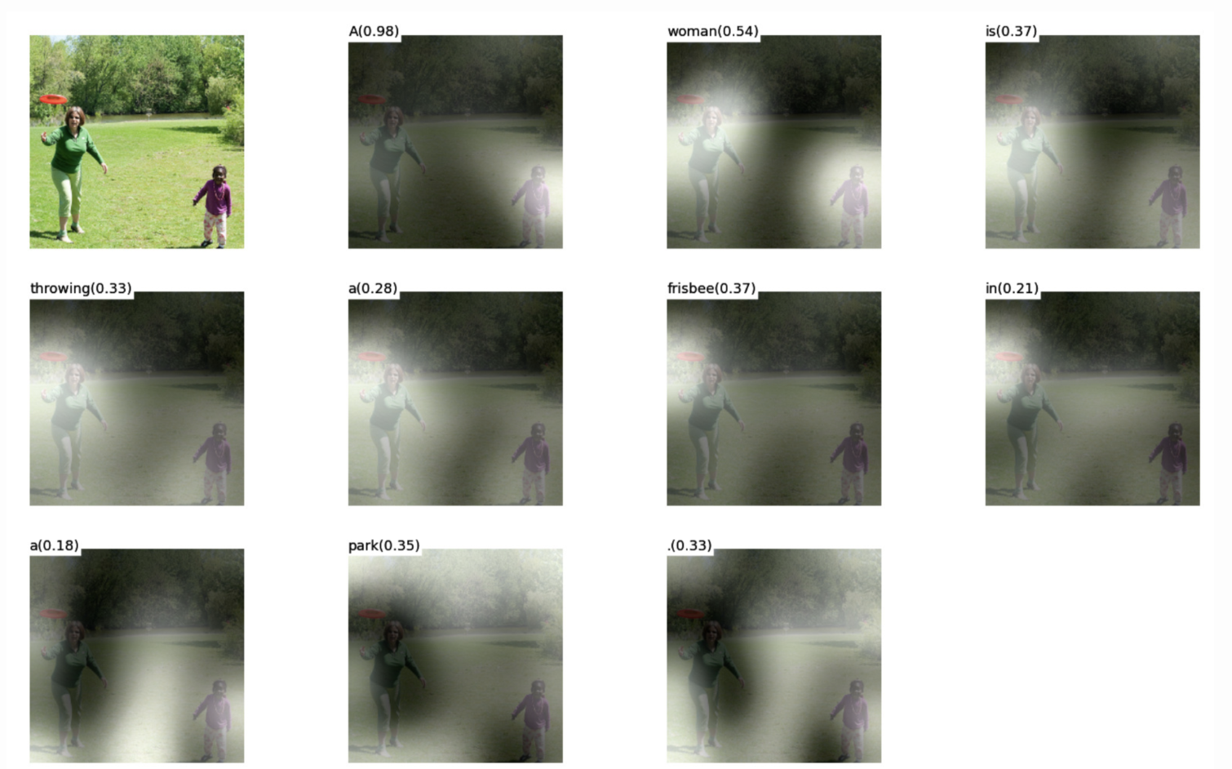
Self-attention
*Xu et al. 2015 – “Show, Attend and Tell: Neural Image Caption Generation with Visual Attention”

Slide 18
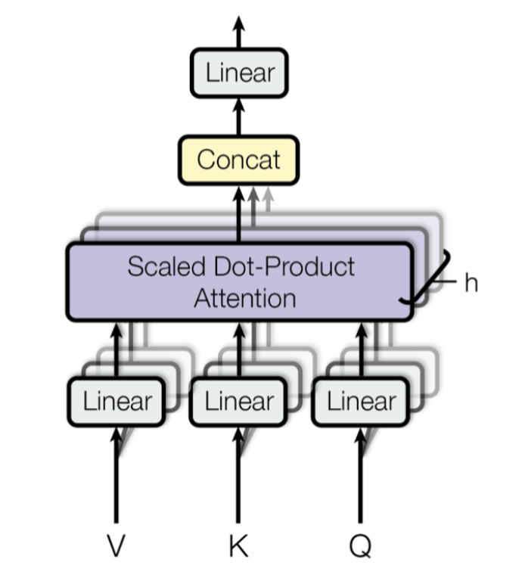
Transformer
Why bother with RNNs at all?
Transformer is built entirely out of self-attention mechanisms through “multi-head self-attention”
Vaswani, et al., 2017 - “attention is all you need”

Slide 19
OpenAI GPT-2 (Radford et al. 19) Language Models are Unsupervised Multitask Learners
Trained on LM task
40GB corpus dataset
1.5B parameters
Source: original paper

Slide 20

OpenAI GPT-2 (Radford et al. 19) Language Models are Unsupervised Multitask Learners
All the downstream language tasks are framed as predicting conditional probabilities and there is no task-specific fine-tuning.
Zero-shot learning:
Summarization:
$$P\left(w\right| “text to summarize”+“ TL;DR:<?>”)$$
Question Answering:
$$P\left(w\right| “text”+“Q:…A:…Q:…A:<?>”)$$
Machine Translation:
$$P\left(w\right| “I like computers=J^{′}aime les ordinateurs; I live in Vancouver=<?>”)$$

Slide 21
GluonNLP: a natural language toolkit
State-of-the-art models
Fast development
Easy deployment
Multiple built-in NLP tasks
…
z
En
Q
A
x
y
文
Sentiment Analysis
Text Generation
Named Entity Recognition
Representation Learning
Machine Translation
Question Answering
Language Modeling

Slide 22
GluonNLP: a natural language toolkit
State-of-the-art models (pre-trained and end-to-end)
BERT, XLNet, GPT-2, Transformer-XL, FastText, etc
model, vocab = gluonnlp.model.get_model(model_name, dataset_name)
Data pre-processing
Multiprocessing, batching, tokenization
 | Gluonnlp
Stanford sentiment treebank | 95.3 （+1.8%）
Stanford question answering dataset | 91.0 （+2.5%）
recognizing textual entailment | 73.6 （+7.2%）
tokenizer = gluonnlp.data.SpacyTokenizer()
Export for deployment
model.export('path')

Slide 23
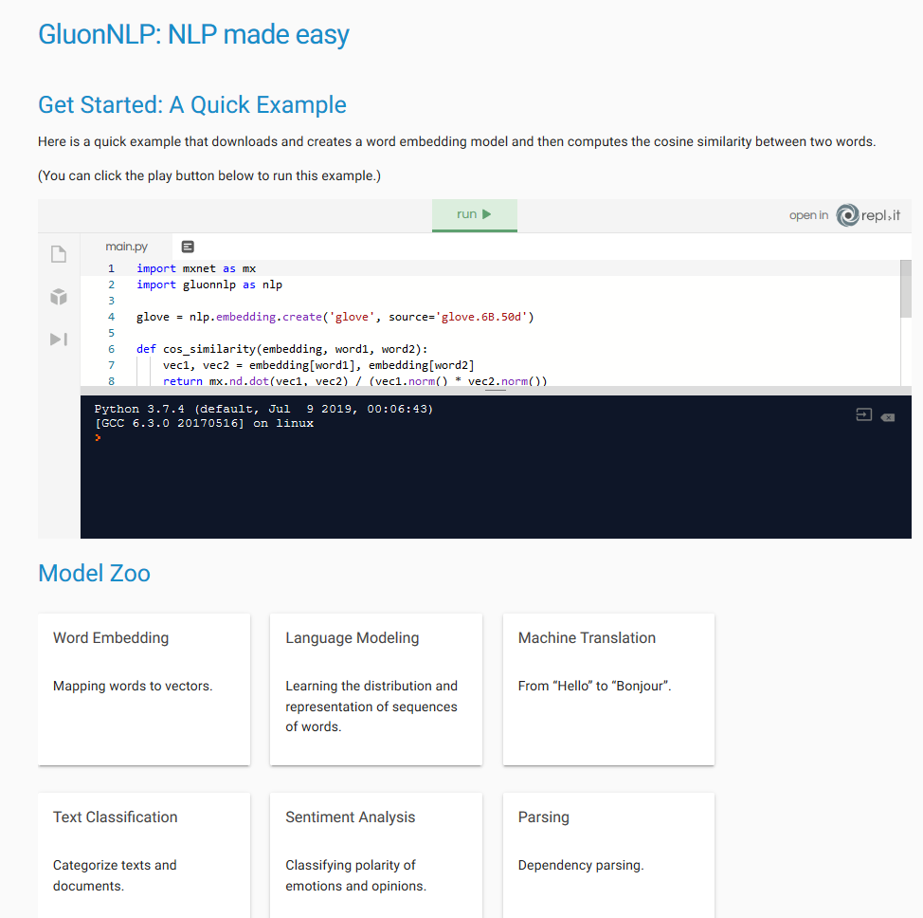
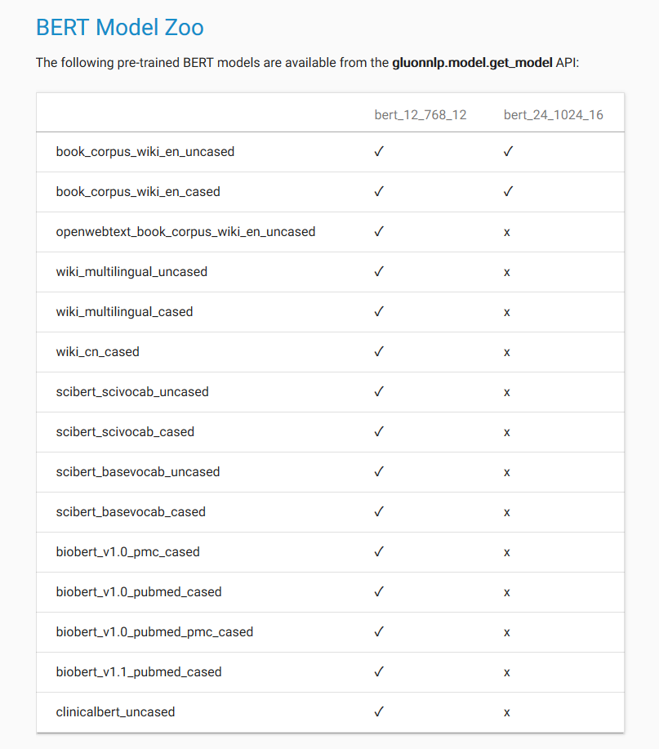

Slide 24
Demo
Github link here: https://github.com/Laurenstc/partner-ml-bootcamp

